Slide 1

Allergy-Safe Recipe Scanner
Group name: The Unnamed
Eric Middlekamp
Daeyong Jung
Hamoud Alhazmi
Wenyu Wang
Timebox 3 - July 09, 2024

Slide 2
Overview
Hamoud - Dataset, Structure, Next Steps
Jung - Backend updates
Eric - Application and Backend updates, What Next?

Slide 3
1.
Dataset

Slide 4
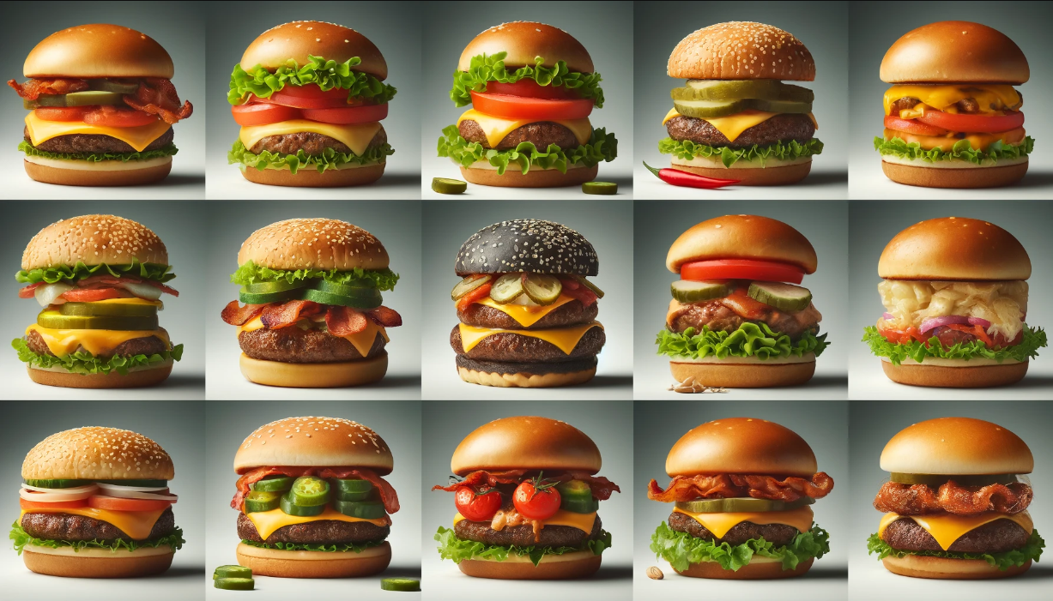
Dataset
Common Allergens in burgers:
Dairy
Gluten
Egg
Soy
Sesame
Nut
Peanut
Fish
Mustard

Slide 5
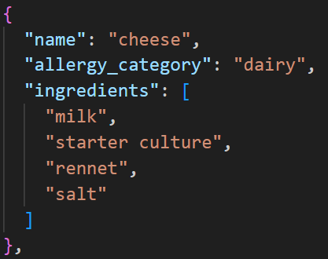
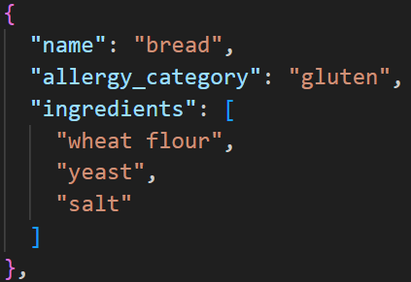
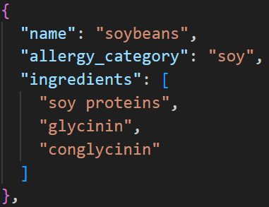
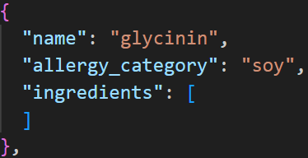
How did we structure the dataset?

Slide 6
Next Steps
Near future:
Add more burger allergens (especially less common ones)
  There are over 18 allergens in burgers
Far in the future:
Include allergens that are not limited to just burgers
Include ingredients in burgers that people dislike, even if they are not necessarily allergic to them
  E.g., pickles, tomato slices, raw onions etc…
Notes:
Corn, Celery, Sulphites and more

Slide 7
2.
Backend updates

Slide 8
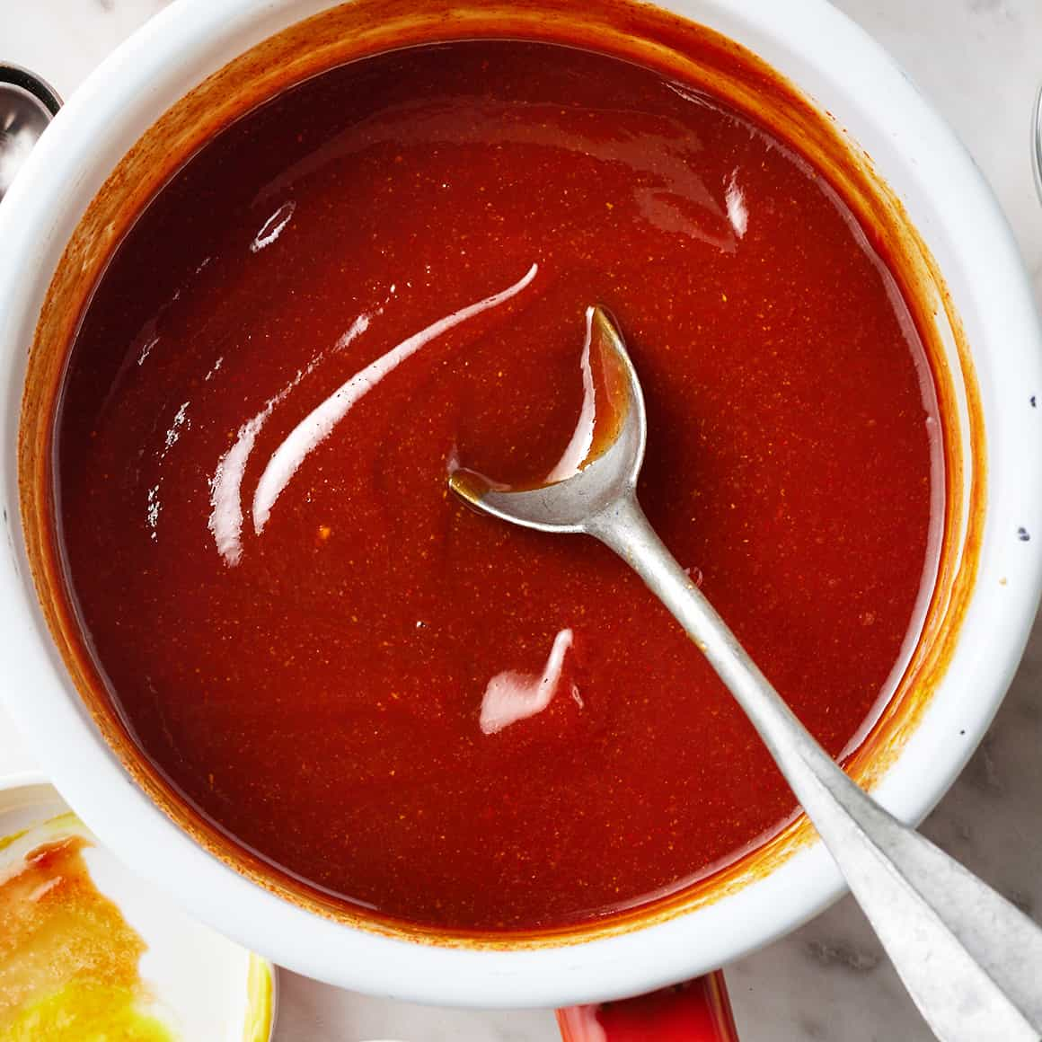
Finds allergens in the recipe
New
Finds sub-ingredients /
child allergens
Provides more information
Finds parent ingredients
Provides more option
Reduce allergy risk
BBQ Sauce
Wheat flour
As thickener
Gluten allergy!

Slide 9
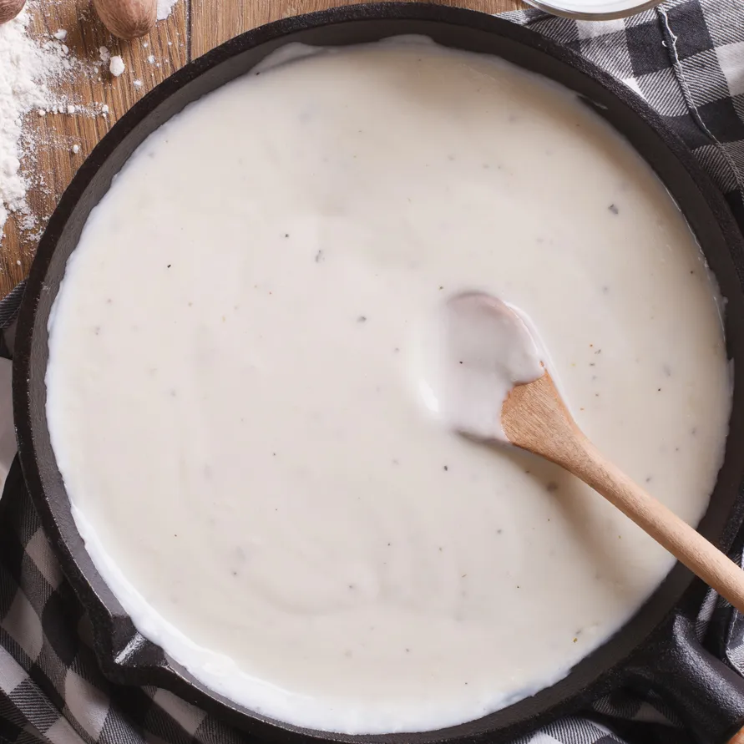
Finds allergens in the recipe
Dairy allergy!
New
Finds sub-ingredients /
child allergens
Provides more information
Finds parent ingredients
Provides more option
Reduce allergy risk
Béchamel Sauce
Milk

Slide 10

Selenium update
Requests

Slide 11
3.
Application and Backend Updates

Slide 12
TB2 Implemented Required Features
User Text Input
Can enter either a URL or text blob
User Management
Has to be a way to differentiate users
Technical Auth Context
Manage user access
Privatized Routes
Proper Routing
Routes between the pages of the application.
MongoDB Atlas
Database for user information

Slide 13
Current State of Application
User Selection of Avoidances
Login is OPTIONAL
Built flow for one time users
Save preferences to account
Save Past Searches
If logged in
View the Query (link or blob) and the results
Backend in Javascript
Handles JWT
Authentication for user preference updates
Signup/Login capabilities
User Dashboard Built
UI is partitioned with demo content
Modal for updating preferences added
Table for result viewing

Slide 14
Challenges
CSS (as always)
UI Design
  Feels very nondescript currently
CORS handling
Creating secure session
  Not the end of the world for this app

Slide 15
Next Steps for Project
Connect to ElasticSearch
ElasticSearch part has specific params, frontend matches those currently
Build out Data
Keep adding ingredients
Try to make it not just specific to one food group
Add Polish
Clean up the UI
Add transitions
Intuitive Error handling
Make it more personal
Features
Password Reset
Email results to yourself
Anything else we think of along the way

Slide 16
Thanks!
Any questions?

